Slide 1
Weekly update
User models

Slide 2
Started up the experiment on OpenSesame
Program has lots of flags, it will shuffle the flag array and use a subset for training individuals.
All four of us went through the program for 40 minutes and we looked at our responses.

Slide 3
Analysis of our Responses
Used alpha to look at performance.
Grouped by item we created a rolling average (window 3) of alpha to show how progress is tracked
Then looked at the difference between the rolling average to show differences in performance of items from one trial to the next
Then these were plotted to see if we could notice some sort of ‘fatigue’ effect which we can then look back into for the experiment.

Slide 4
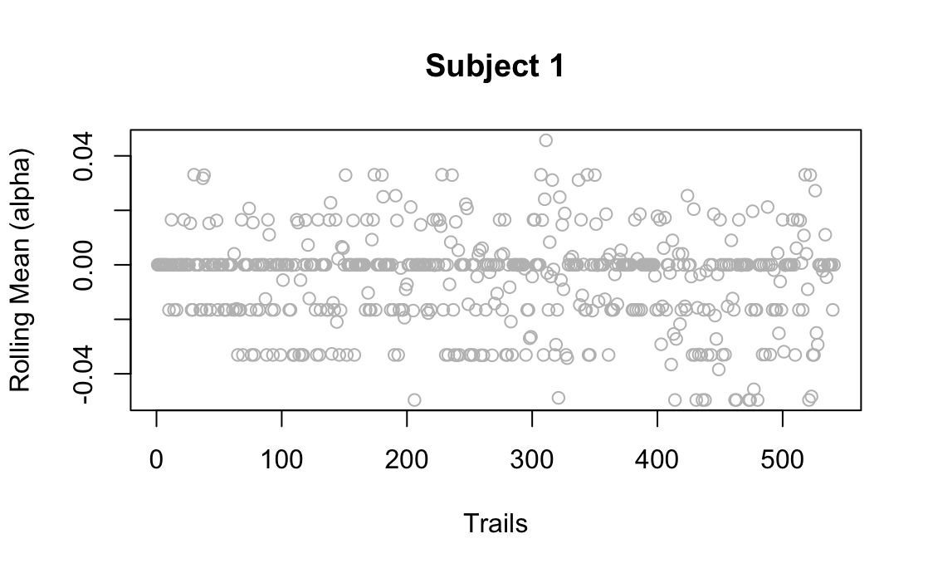
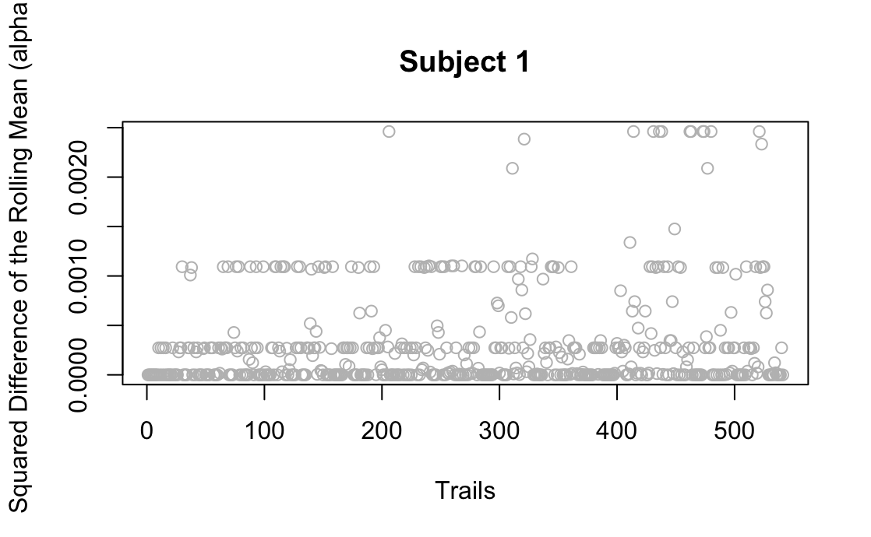
Subject 1
60 minutes total
Approx 21 minutes

Slide 5
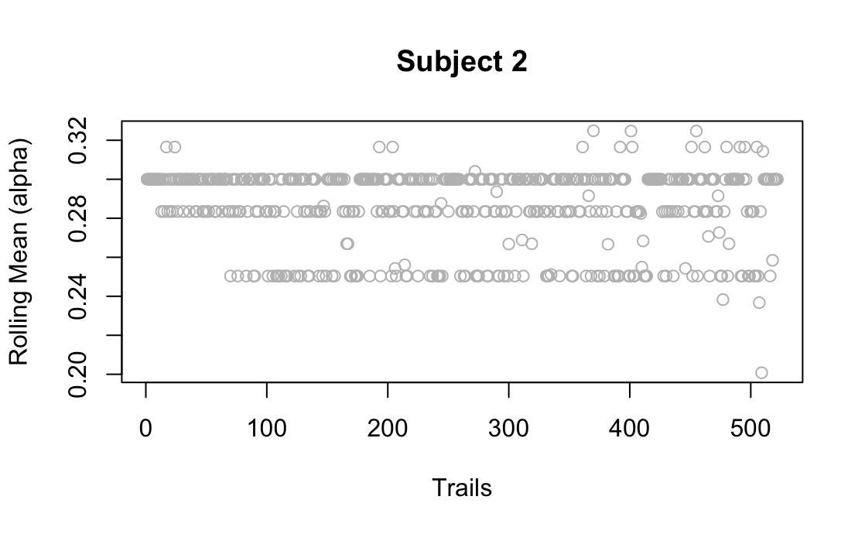
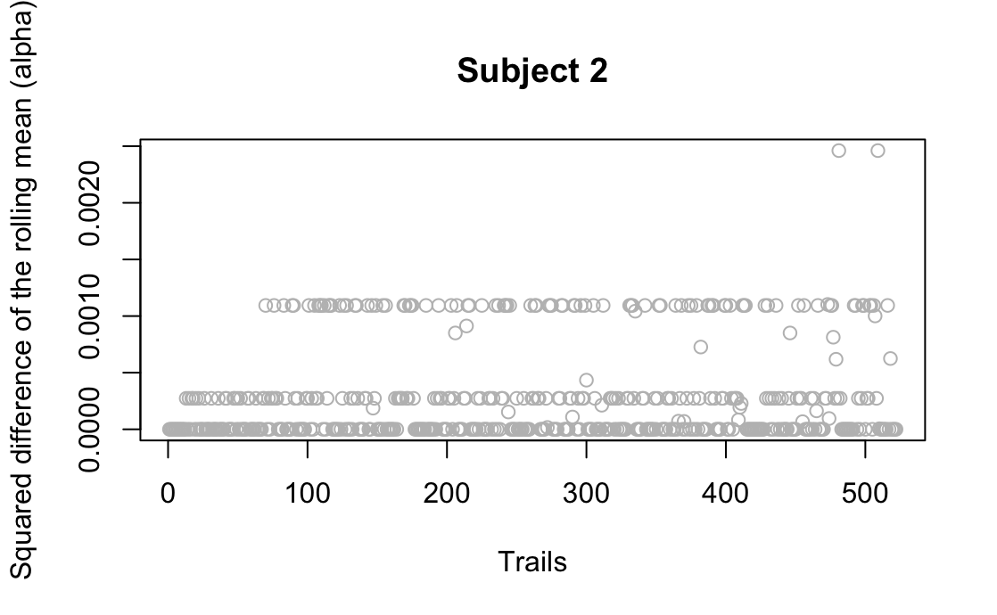
Subject 2
This one was particularly difficult as performance was overall REALLY good therefore, there was not a lot of issues of fatigue
Had more trials because feedback time was shorter
Approx 34 minutes

Slide 6
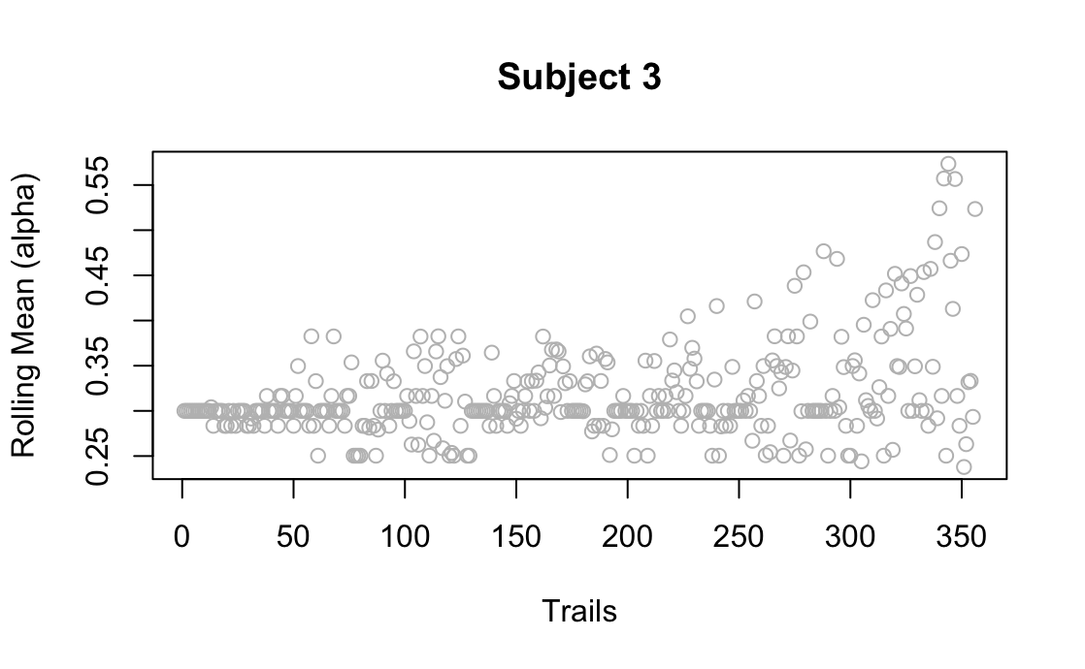
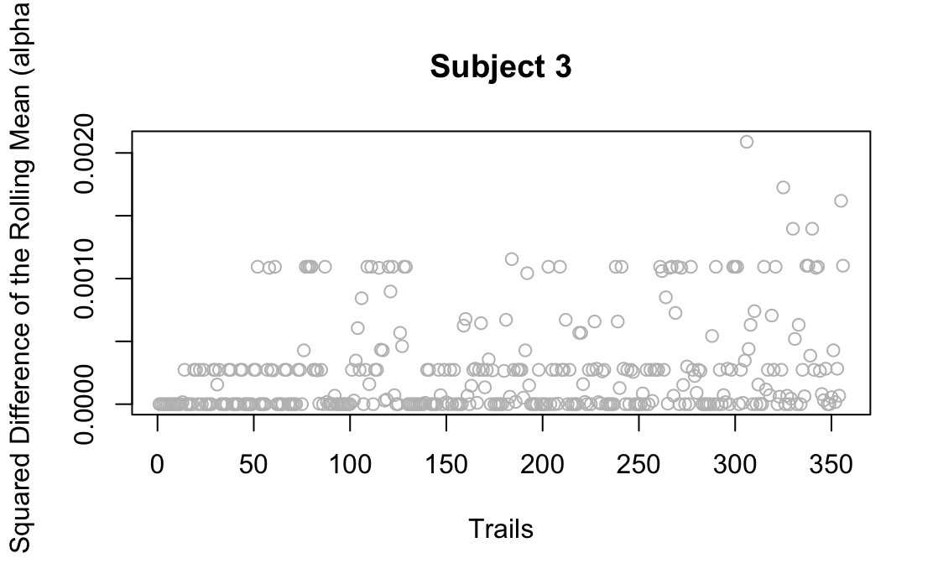
Subject 3
Approx 35 minutes

Slide 7
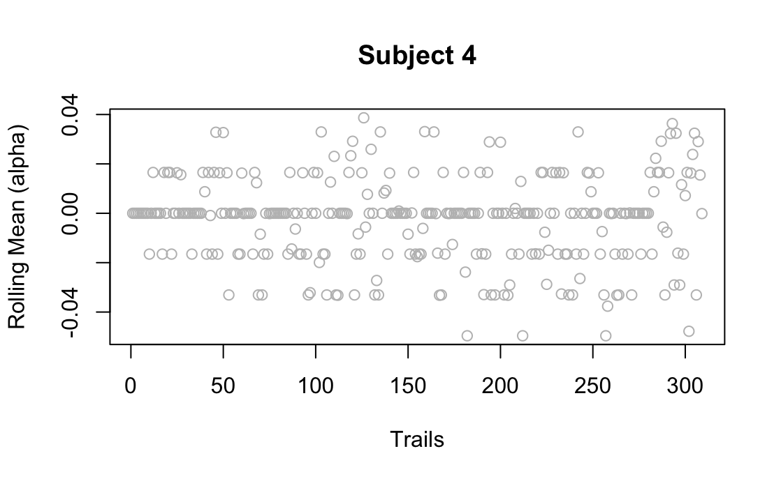
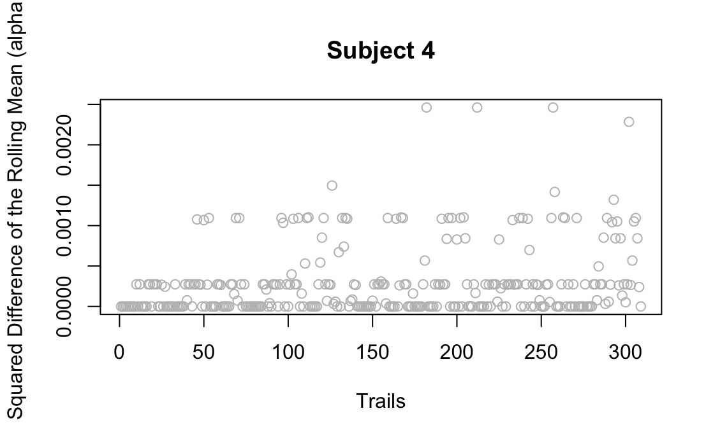
Subject 4
Approx 22.5 minutes

Slide 8
Next steps
Use this rolling alpha difference as a basis to find breaks during the experiment
Figure out how to monitor breaks and timings using opensesame so that overall studying time is the same for all conditions
Finalise the flag subset for the experiment.
Create a final test with the flags to look at how learning through SlimStampen affected performance
Gather participants to do the experiment with the three conditions

